Slide 1
Introduction to the concepts of Communication, Dissemination & Exploitation
Stephanie Weber,
European IP Helpdesk c/o EURICE – European Research and Project Office GmbH

Slide 2
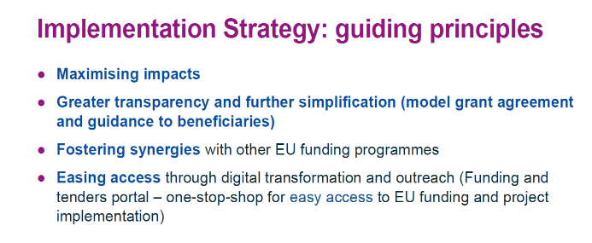
Make a difference – make an impact.
Communication, dissemination and exploitation activities are an integral part of Horizon projects – and in Horizon Europe in particular! - to help maximise the impacts of EU research & innovation funding.

Slide 3
What is in it for you?
Improves your proposal’s chances of success
Increases the visibility of your research/business, enhances your reputation and helps gain understanding and support
Opens up other funding sources and business opportunities by explaining how your project successfully tackles current issues and challenges
Supports the spread of knowledge and allows that knowledge to be built upon
Notes:
It positively affects our daily lives by creating new jobs, improving public knowledge and influencing a change in policy for example

Slide 4
Contractual Obligation
Rules for Participation
Article 39: Exploitation and Dissemination
Article 40: Transfer and Licensing
Article 41: Access Rights
Horizon Europe Model Grant Agreement
Article 16: Intellectual Property Rights (IPR) – Background and Results – Access Rights and Rights of Use
Article 17: Communication, Dissemination & Visibility
→ Annex 5 “Specific Rules”

Slide 5
Pathway to Impact
“Logical steps towards the achievement of the expected impacts of the project over time, in particular beyond the duration of a project.
A pathway begins with the projects’ results, to their dissemination, exploitation and communication, contributing to the expected outcomes in the work programme topic, and ultimately to the wider scientific, economic and societal impacts of the work programme destination.”

Slide 6
Results – Outcomes – Impacts
Results
Outcomes
Impacts
Additional specification:
Research outputs

Slide 7
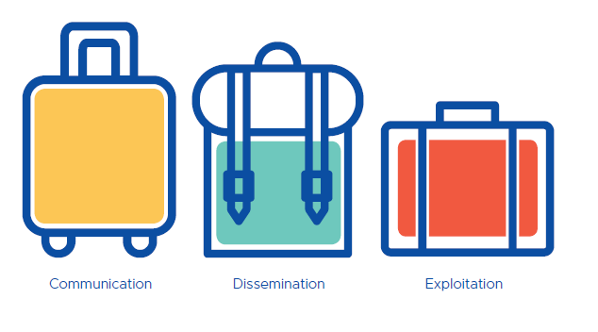
Central Definitions
Notes:
Understanding the concepts behind communication, dissemination and exploitation, will help you create successful and targeted action plans

Slide 8
Communication
Communication measures should promote the project throughout the full lifespan of the project. The aim is to inform and reach out to society and show the activities performed, and the use and the benefits the project will have for citizens.
Notes:
Objective: Reach out to society at large to highlight benefits of EU-funded research & innovation projects
Focus: Inform about and promote the project AND ist results/achievements
Target Audience: Address multiple audiences outside the project‘s community

Slide 9
Dissemination
The public disclosure of the results by appropriate means, other than resulting from protecting or exploiting the results, including by scientific publications in any medium.
Notes:
Objective: Transfer knowledge and results to enable others to use and take up results
Focus: Describe and ensure results are available for others to use → focus on results only
Target Audience: Audiences that may have an interest in using your results

Slide 10
Exploitation
The use of results in further research and innovation activities other than those covered by the action concerned, including among other things, commercial exploitation such as developing, creating, manufacturing and marketing a product or process, creating and providing a service, or in standardisation activities.
Notes:
Objective: Effectively use results through appropriate exploitation routes
Focus: Make concrete use of results (not limited to commercial use!)
Target Audience: People/organisartions – inside and outside the project - that make concrete use of the results

Slide 11
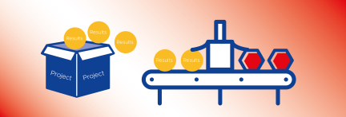
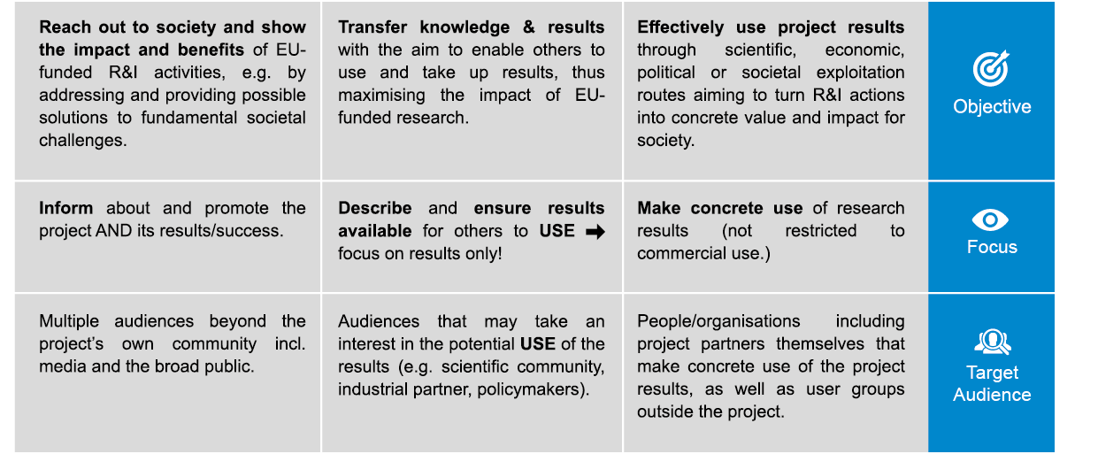
In a nutshell
Communication
Dissemination
Exploitation

Slide 12
Timing
Strategic planning of communication, dissemination and exploitation activities already starts before the project at the proposal stage.
Plans need to be constantly monitored, reviewed and potentially adjusted throughout the course of the project.
Exploitation of results
Dissemination of results
Communication of project and results
First Results
Further results may occur during the project – not only at the end
– that may initiate: a) dissemination activities, b) dissemination and linked communication actions, and/or c) exploitation measures.
Start
Project Implementation
End

Slide 13
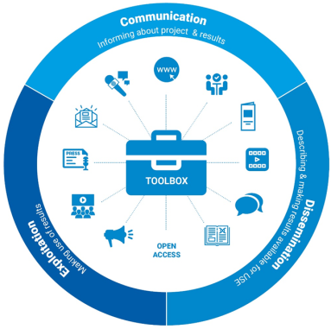
Potential Tools

Slide 14
Potential Tools
First define the purpose of the communication, dissemination and/or exploitation measure, and who is addressed by it, then identify the right tool and carry out the activity that will optimally convey your message.

Slide 15
Monitoring
Is it effective?
Who should you tell?
Why are your telling them?
What message will you deliver?
How will you deliver the message?
How will you follow up any response?
If not, re-consider & adjust!

